Slide 1

EXCELSIOR – Hotel Room Booking System

Slide 2
CONTENT
Introduction
Problem Statement
Requirement Specification
Diagrams
Limitations
Screenshots
Conclusion
Future Scope
References

Slide 3
INTRODUCTION
Hotel Booking website.
Online way to book rooms in less time.
User Friendly Website.

Slide 4
EXISTING SYSTEM PROBLEM
Manual
Security
Time
Information Retrieval
Information Maintenance

Slide 5
Requirement Specifications

Slide 6
HARDWARE SPECIFICATION
DURING DEVELOPMENT
Processor - INTEL(R) Core(TM) i7-8700 CPU
RAM - 16.0 GB (15.8 GB usable)
OS – Windows 10 (64-bit Operating System)
Hard Disk– 1TB

Slide 7
SOFTWARE SPECIFICATION
BROWSER :
Microsoft Edge 2018
Google Chrome
Opera (v58.0.3135.127)
Firefox (v66.0.3)
Testing Tool :
Jasmine and e2e Testing
XUNIT
IDE :
SSMS 2017
Visual Studio 2017 (v15.9.7)
Visual Studio Code (v1.32.3)

Slide 8
ADVANTAGES OF EXCELSIOR
Time Savvy.
User Friendly.
Less Chances of Human Errors.
Wide Variety and Options available.
Easy Search Options.
Quick Booking.

Slide 9
LIMITATION
High Maintenance Cost
Security Limitations
User Data Privacy

Slide 10
Diagrams

Slide 11
LIST OF DIAGRAMS
USE CASE DIAGRAM
DATABASE DIAGRAM
CLASS DIAGRAM
ER DIAGRAM
DATA FLOW DIAGRAM →
SEQUENCE DIAGRAM
ACTIVITY DIAGRAM(ADMIN)
ACTIVITY DIAGRAM(CUSTOMER)
(ADMIN)
DFD LEVEL 0
DFD LEVEL 1
DFD LEVEL 2.1, 2.2, 2.3, 2.4
(CUSTOMER)
DFD LEVEL 1
DFD LEVEL 2.1 , 2.2

Slide 12
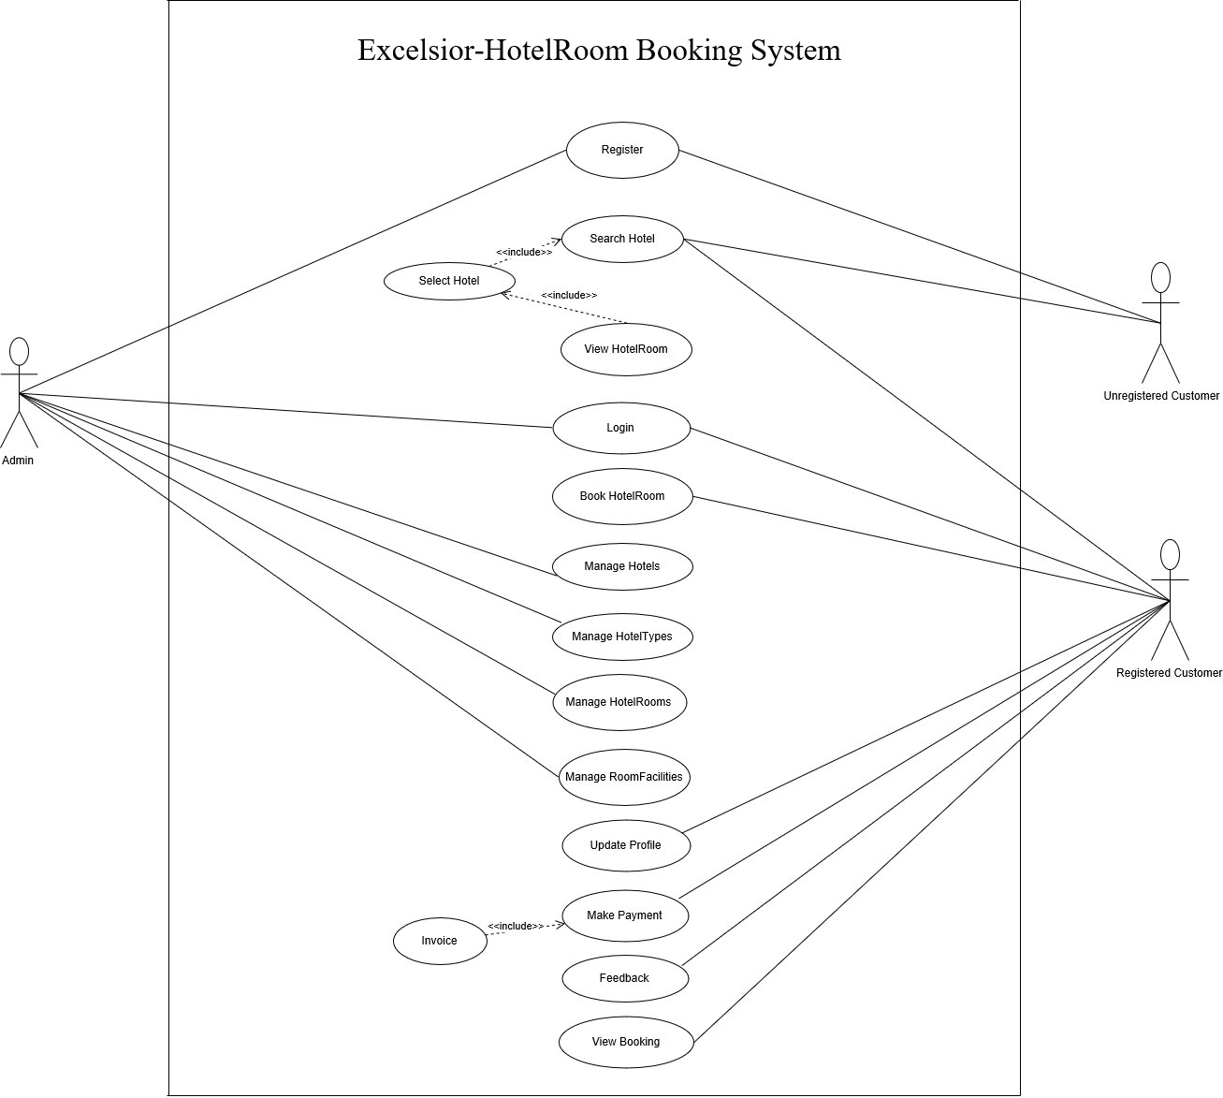
USE CASE

Slide 13
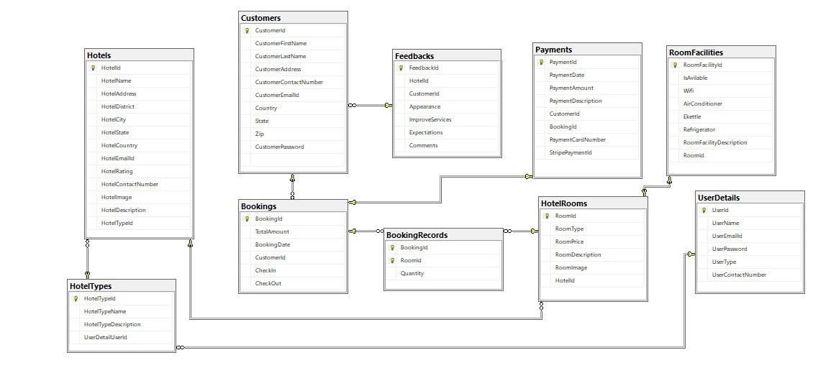
DATABASE DIAGRAM

Slide 14
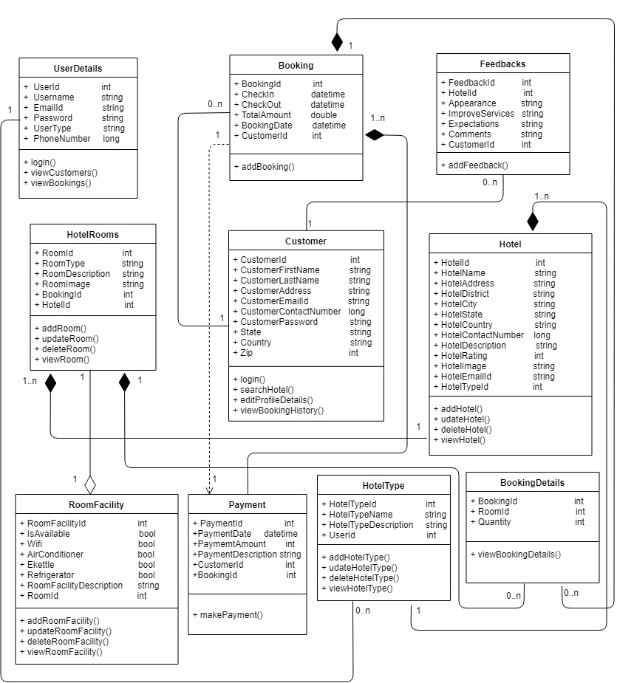
CLASS DIAGRAM

Slide 15
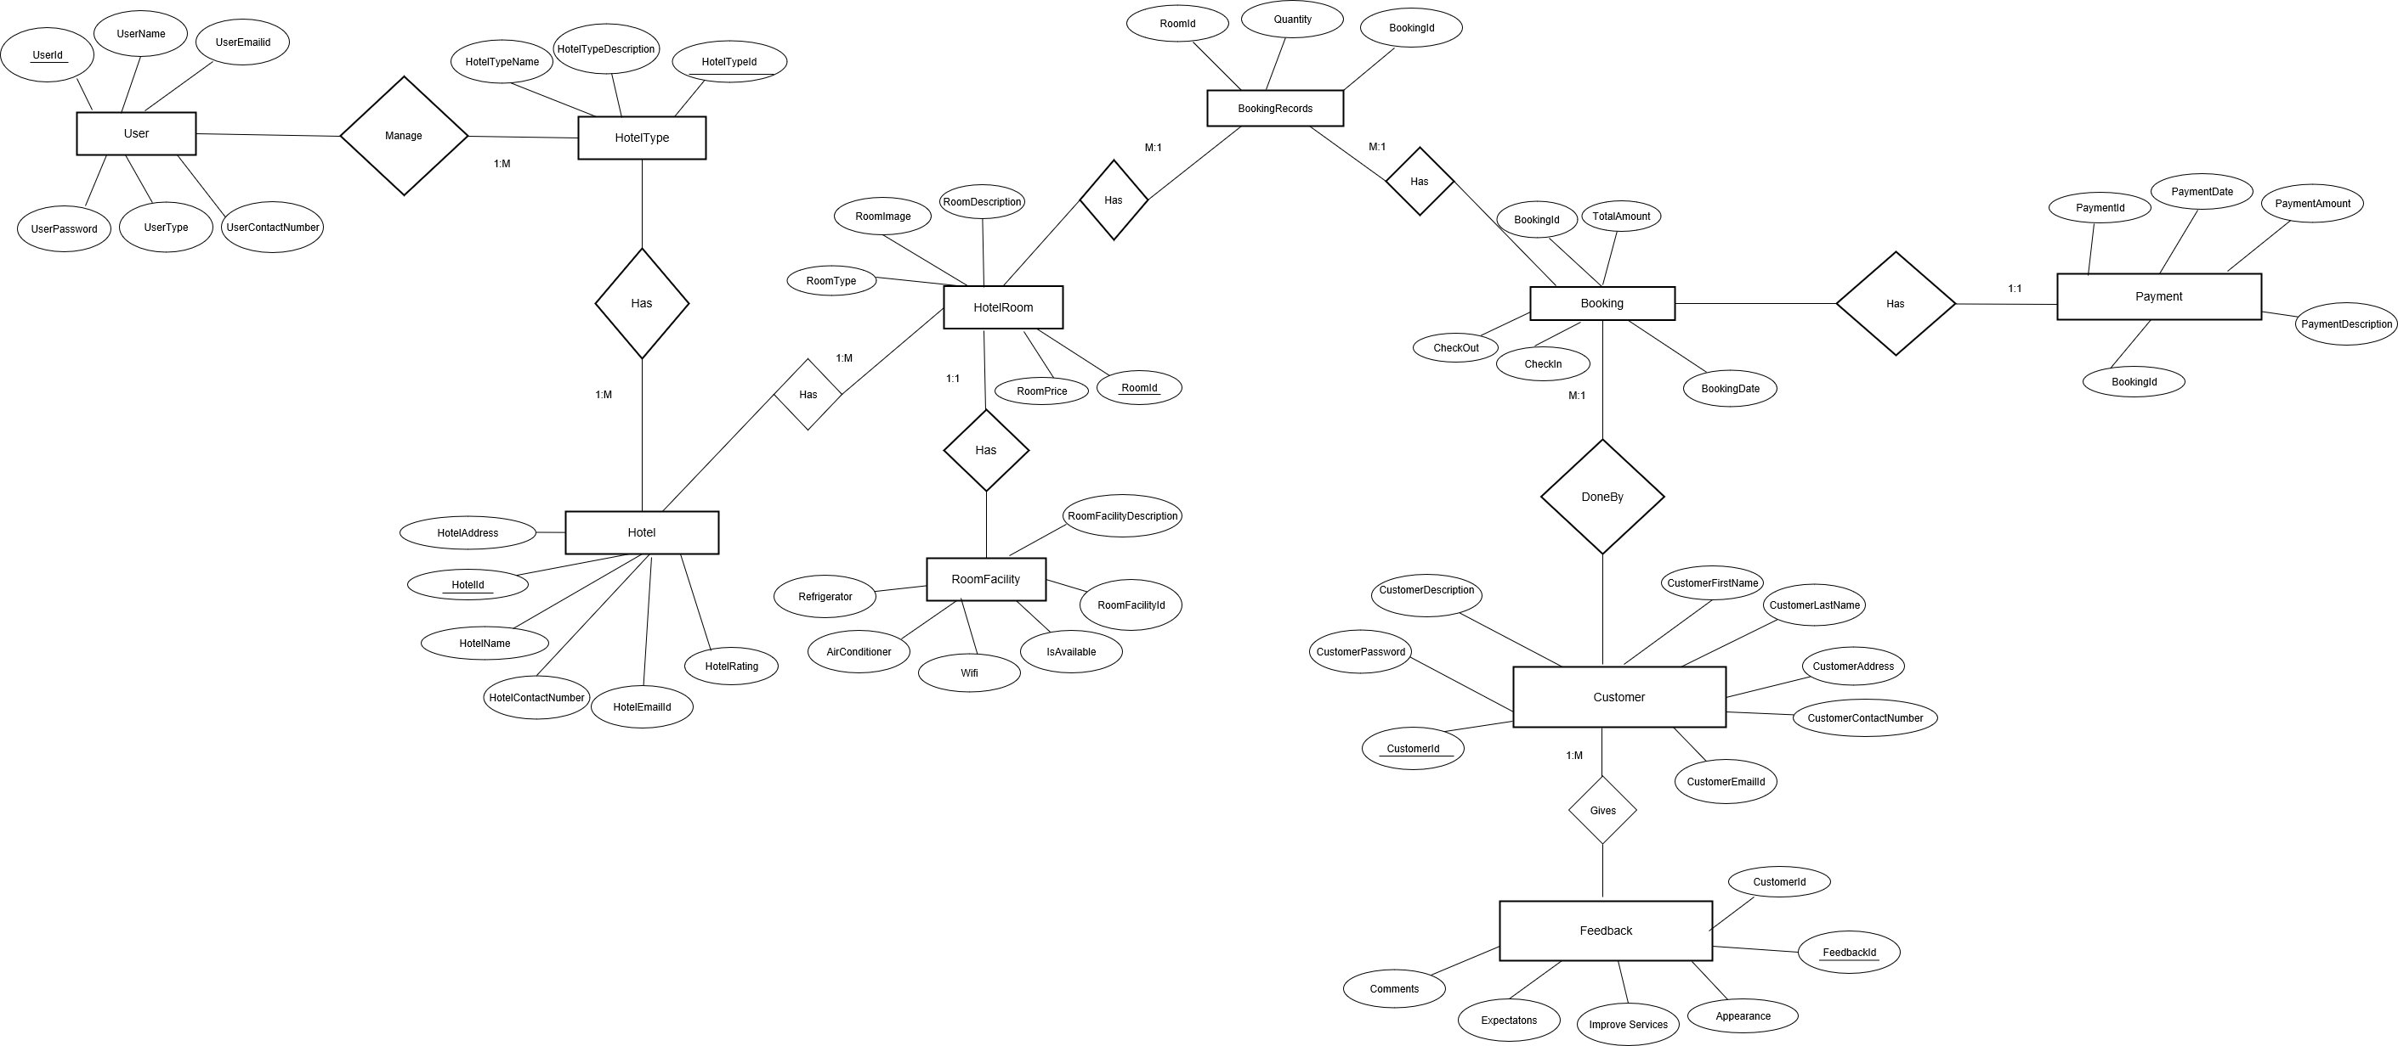
ER DIAGRAM

Slide 16
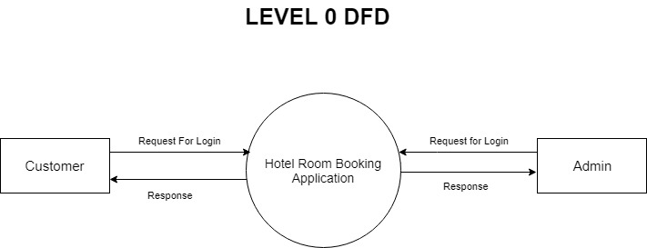
DFD –DATA FLOW DIAGRAM

Slide 17
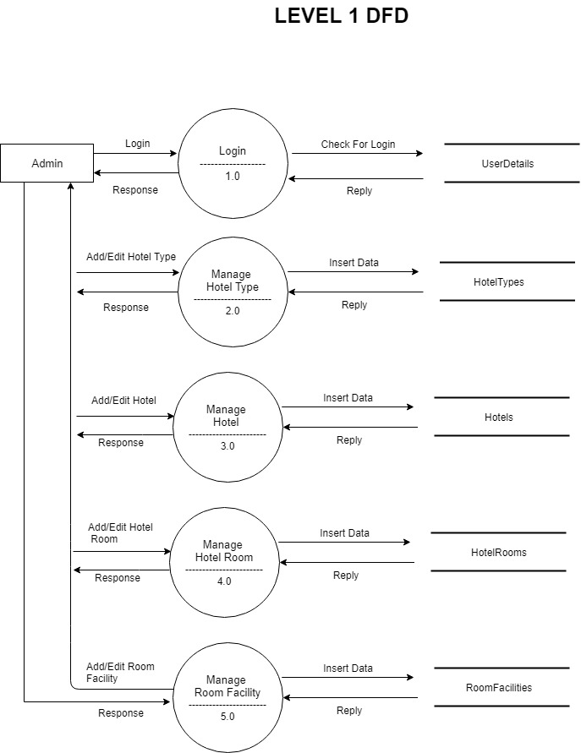
DFD : Level 1

Slide 18
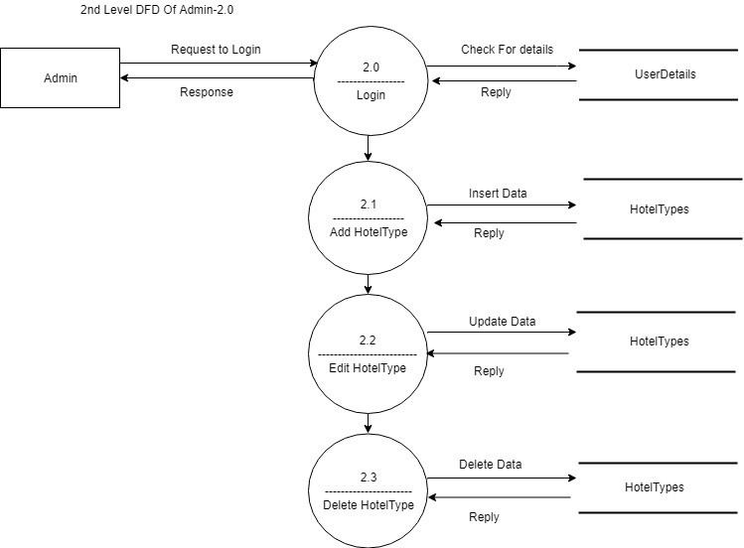
DFD : Level 2

Slide 19
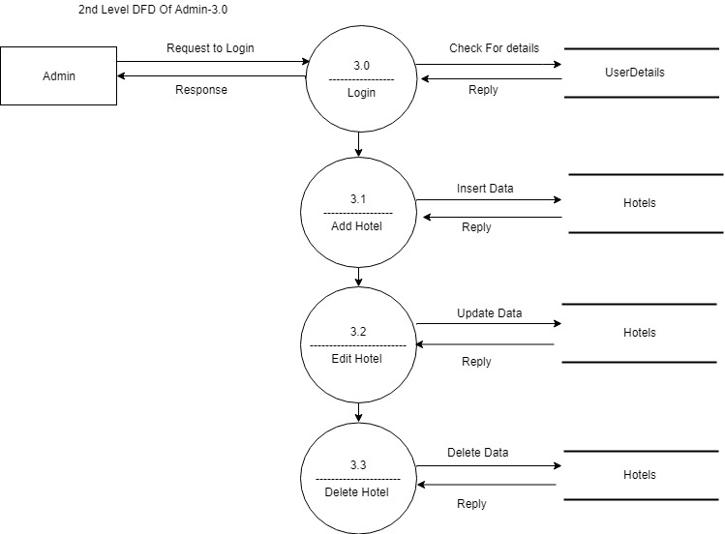

Slide 20
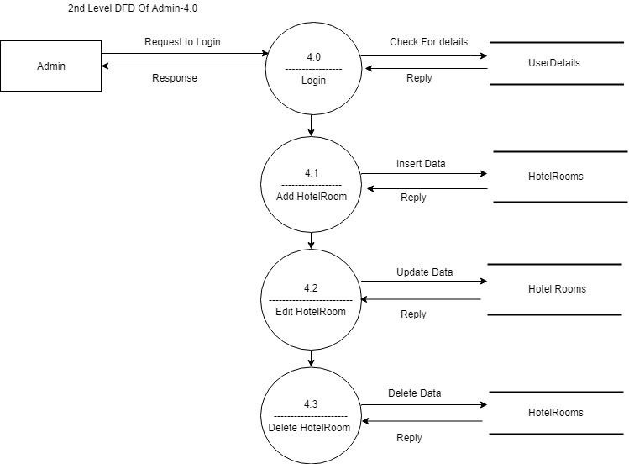

Slide 21
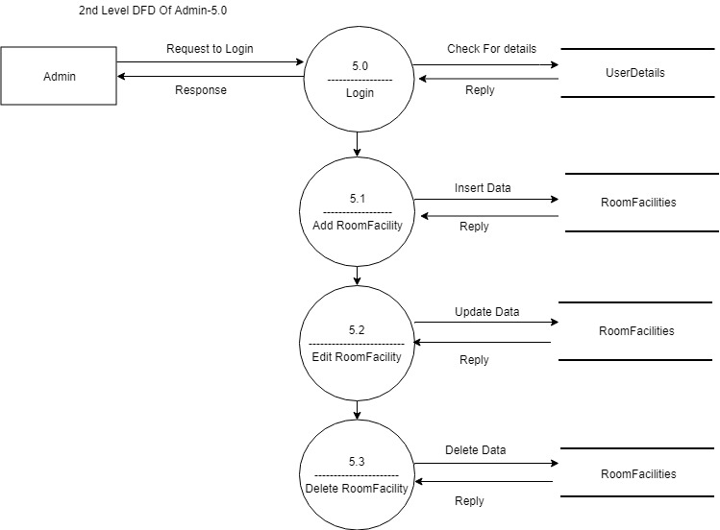

Slide 22
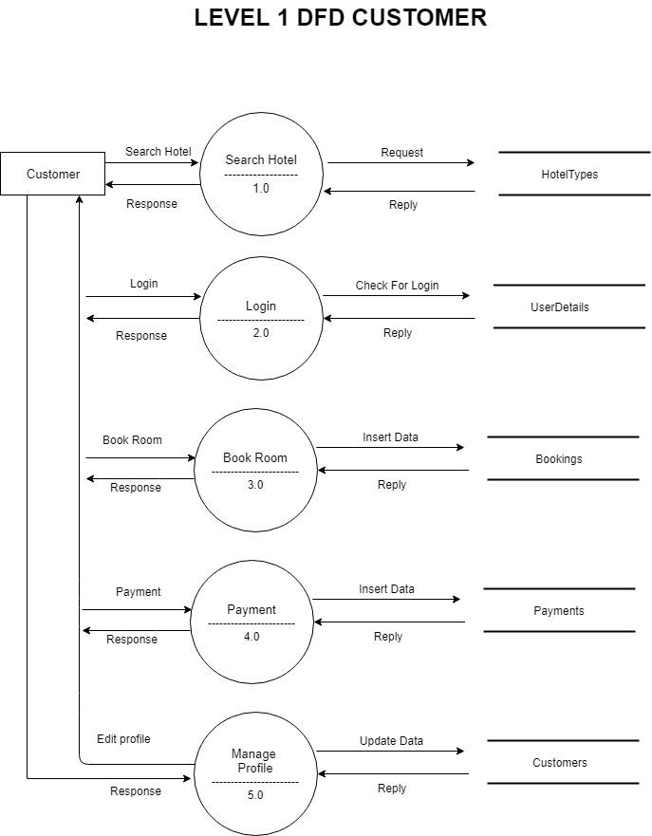

Slide 23
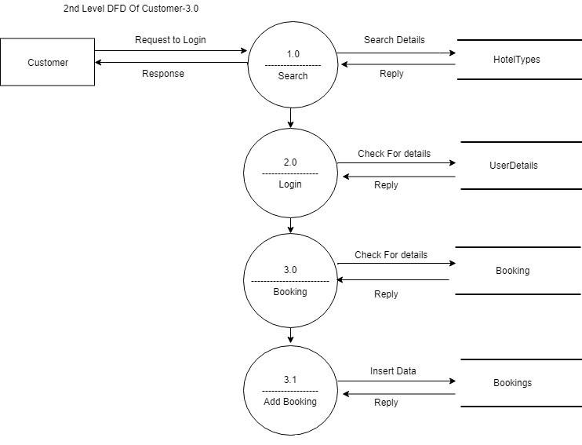

Slide 24
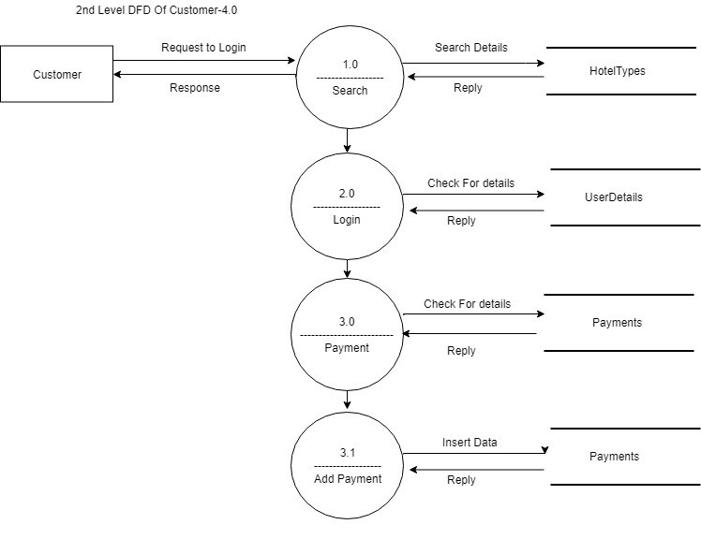

Slide 25
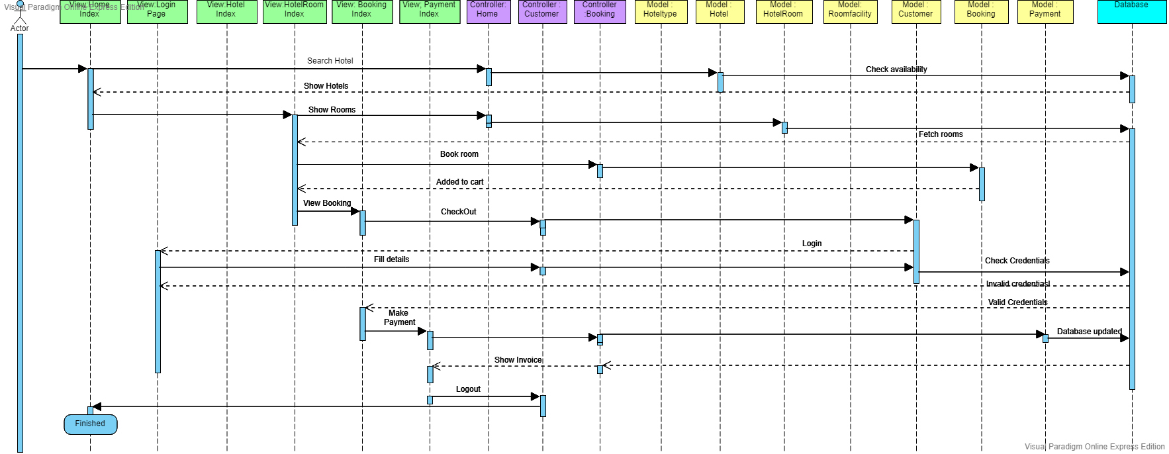
SEQUENCE DIAGRAM

Slide 26
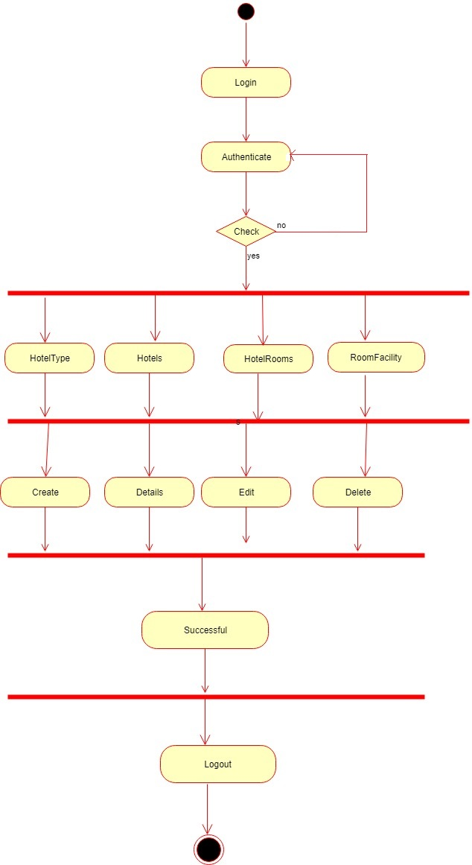
ACTIVITY DIAGRAM (ADMIN)

Slide 27
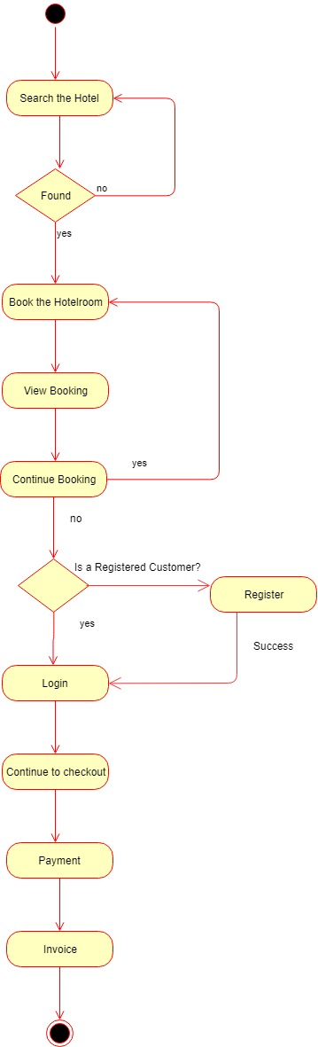
ACTIVITY DIAGRAM (CUSTOMER)

Slide 28
Screenshots

Slide 29
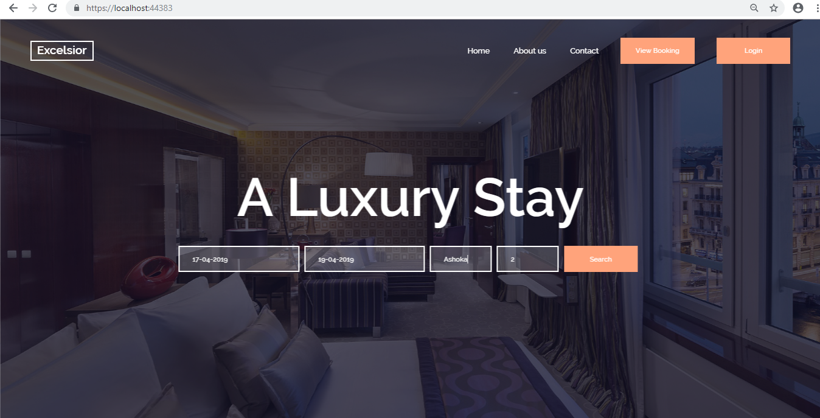

Slide 30
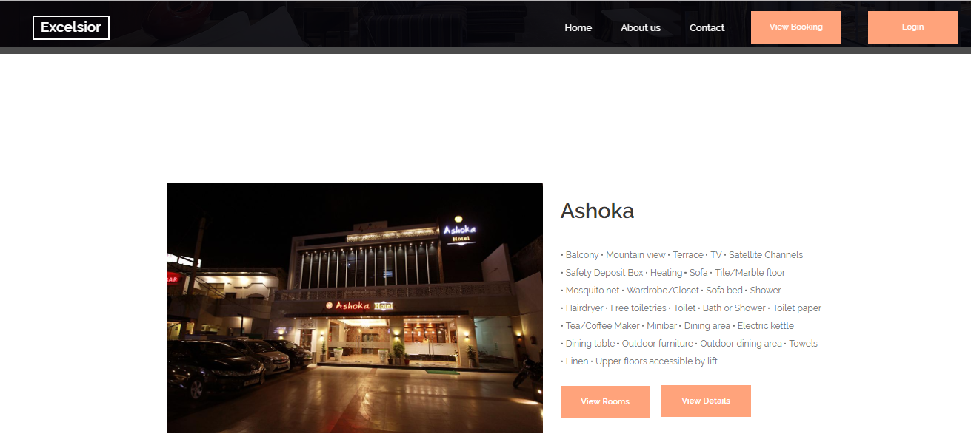

Slide 31
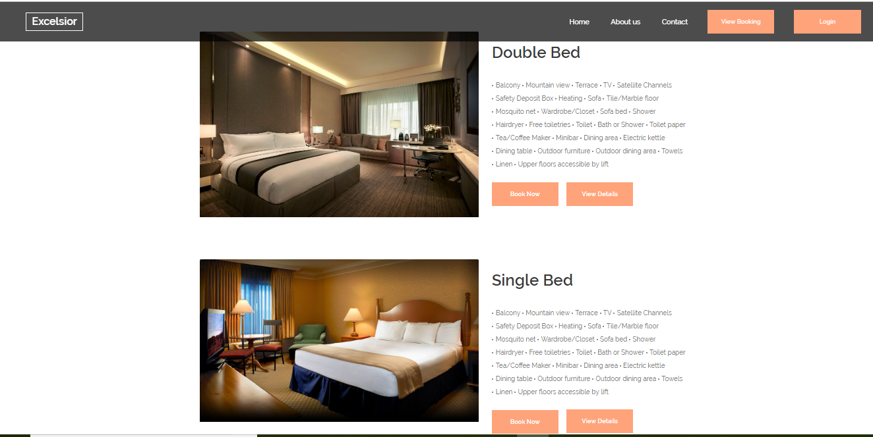

Slide 32
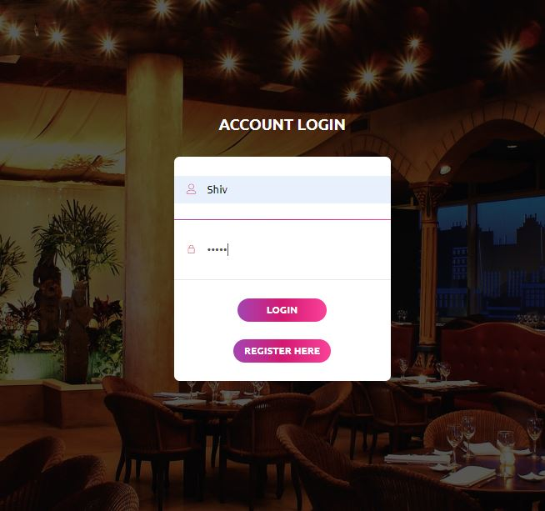

Slide 33
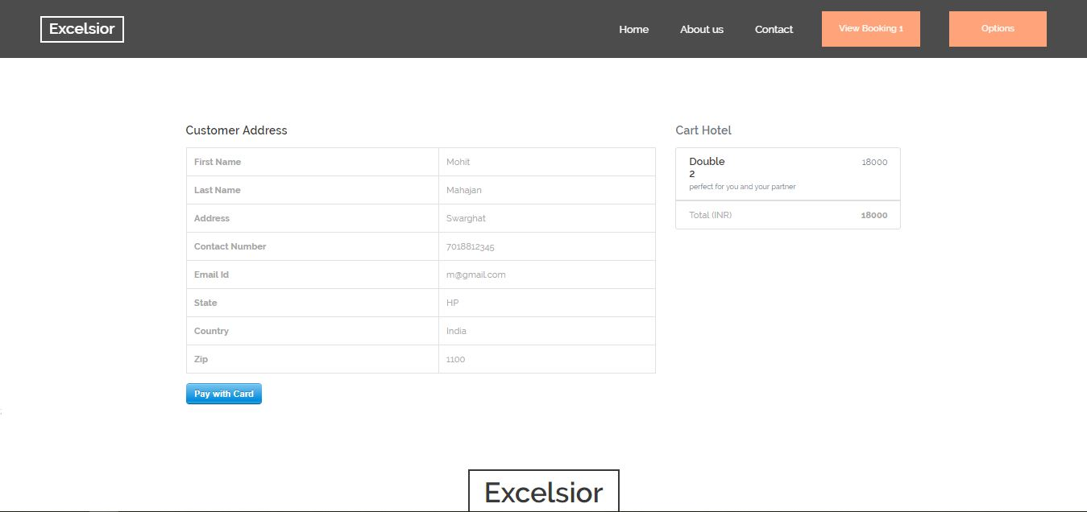

Slide 34
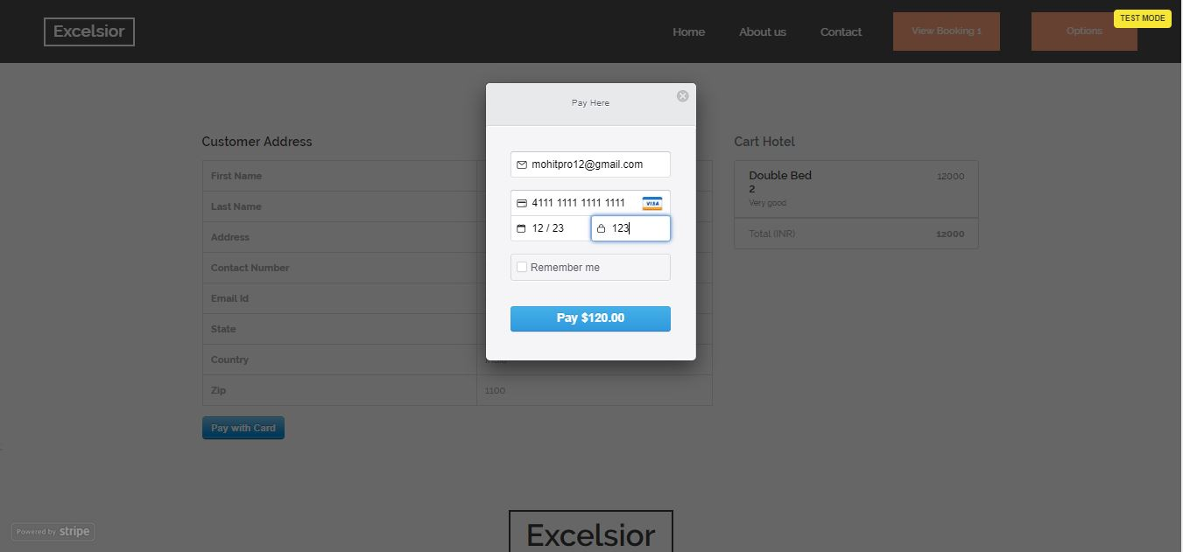

Slide 35
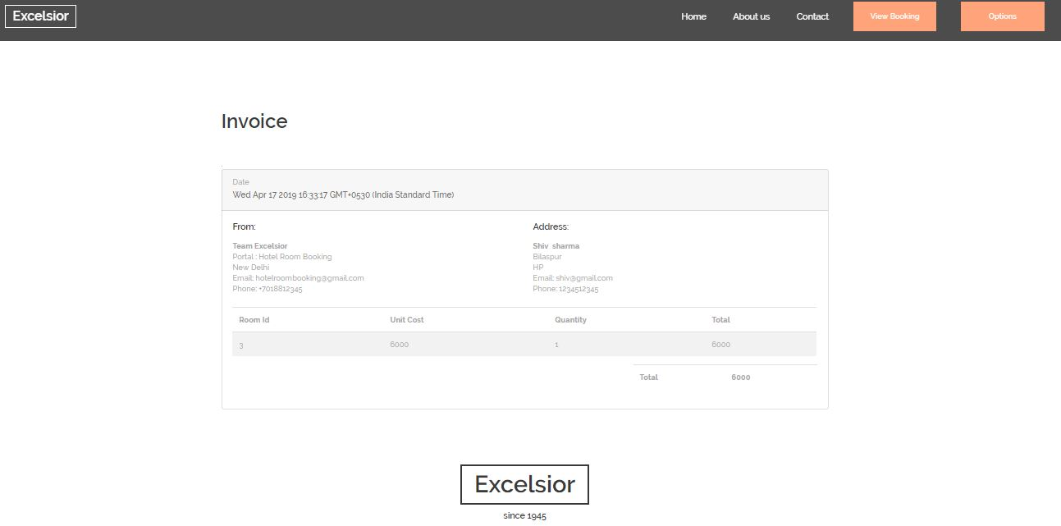

Slide 36
CONCLUSION
The positives include easy access of website, Time savvy and fast booking of hotels.

Slide 37
FUTURE SCOPE
More secure.
Customer behavior based suggestions.
Fast rendering.

Slide 38
REFERENCES
Special thanks to all the people who made and released these awesome resources for free:
Presentation template by Colorlib
Photographs by Google Images
Angular7 Docx
Microsoft Docx
Google.com
Booking.com
Trivago.com
Youtube.com
Wikipedia.com

Slide 39
THANKS!

